Slide 1
Unit Testing
Giuseppe Scanniello
Simone Romano
Michelangelo Esposito

Slide 2
Terminology
Test: The act of exercising a software system with a test case
Its goal is to break systems or demonstrate their correct execution
Test case: a recognized work product
It is associated to a system behavior
It has a set of inputs and expected outputs (i.e., oracle)
Test suite: Set of test cases

Slide 3
Unit testing
A way of answering "Do the parts of my system perform correctly alone?"
Level of testing where units (or components) are individually tested
Unit: minimal part of a system that can be tested in isolation
In procedural software systems a unit is:
Procedure, function, body of code that implements a single feature, …
In OO software systems a unit is:
Class, method, …

Slide 4
How to design (unit) tests?
Happy path testing:
Tests for the correct usage of the software system
Unhappy path testing:
Tests for an incorrect usage of the software system

Slide 5
How to execute them?
Executing tests should be automatic
Design once, execute many times
Need of test automation

Slide 6
Test automation
The use of software to perform or support test activities like test execution and results checking
Benefits:
Cost reduction---the tester should just press a button to start executing tests
Human error reduction---providing input values and checking outcomes manually is an error-prone activity
Foster regression testing---repeatable tests allow easily testing a system after modifications to it

Slide 7
unittest library
A test automation module (in particular, a unit testing module)
Included in the Python standard library
Similar (xUnit) frameworks are available for other languages

Slide 8
xUnit frameworks
CUnit---C
CppUnit---C++
COBOLUnit---Cobol
DUnit---Delphy
FUnit---Fortran
JUnit --- Java
JSUnit---JavaScript
mlUnit---Matlab
NUnit---.Net
PHPUnit---PHP
SUnit---Smalltalk
SimplyVBUnit---Visual Basic
XCTest---Xcode
…

Slide 9
Basic concepts
Assertion, it verifies a single expected result
Test method, it verifies a single system behavior---it corresponds to a test case
Test class, it embodies all test methods for a given class---it can be seen as a test suite

Slide 10
Assertion
A method called by a test method to verify a single expected result
assertTrue assertFalse
assertIsNone assertNotNone
assertEqual assertIsInstance
assertRegexpMatches

Slide 11
Assertion
Examples:
assertTrue(a)
assertEqual(0,a)
assertIsInstance(cls,obj)
Cause a test method to fail if a!= true
Cause a test method to fail if a!=0
Cause a test method to fail if obj is not of type cls
Expected output
Actual output

Slide 12
Assertion
All assertions accept a string argument (in the last position) to describe the reason of a failure
Examples:
assertTrue(a, “value is not True”);
assertEquals(0, a, “value not 0”);

Slide 13
Test class
A class that embodies a set of test methods and related code
Usually, there is a test class for each system class
A test class must inherit from unittest.TestCase

Slide 14
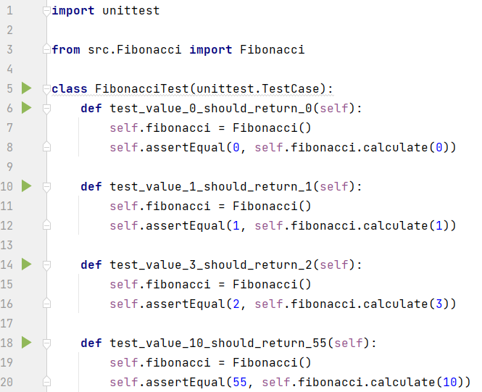
Typical test class structure
Typically, the test class name for a class “A” is “ATest” (but not always)
Test class must inherit from unittest.TestCase
Assertion (one of several kinds)

Slide 15
Test method
Test method names MUST start with “test_”:
def test_<something>: …
Test method names should be meaningful; they should provide a clear idea what the test is for

Slide 16
Test method
It can contain any code:
Local variables, calculations
Call to helper methods
…
In particular, it should always contain at least one assertion

Slide 17
Test method
Example:
def test_list_size(self):
list = []
list.append(1)
list.append(2)
list.append(3)
self.assertEqual(3, len(list))

Slide 18
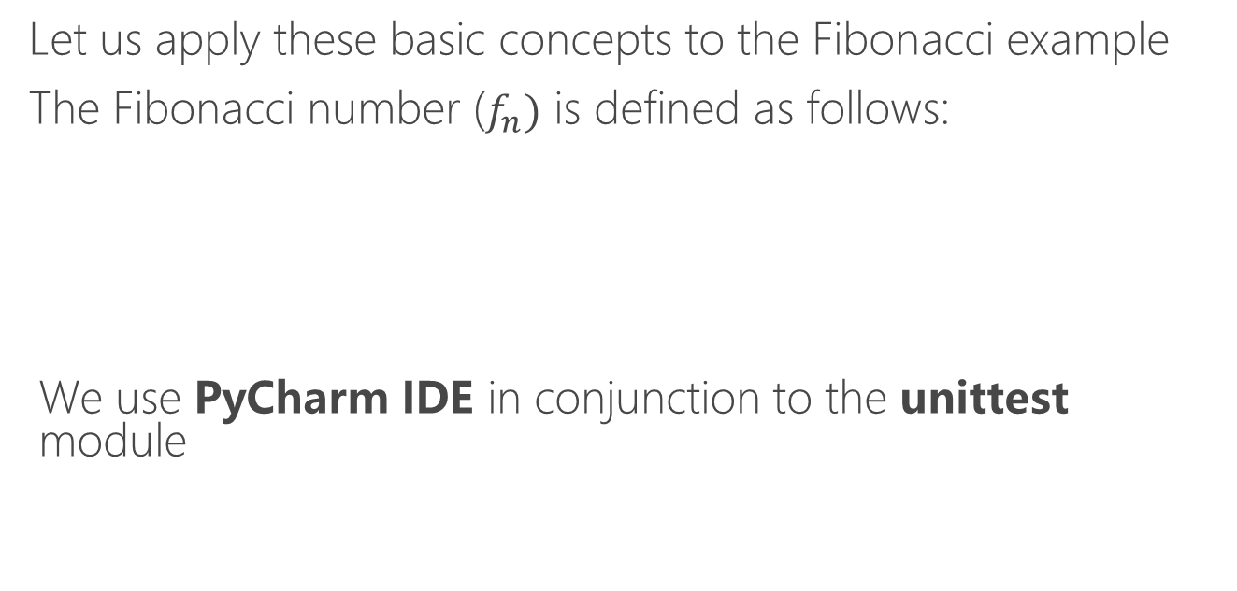
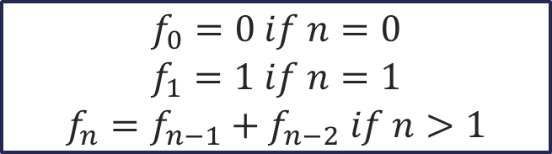
Fibonacci example

Slide 19
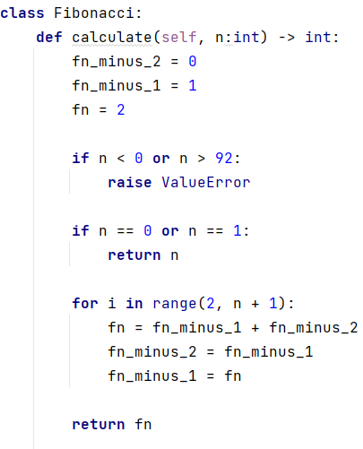
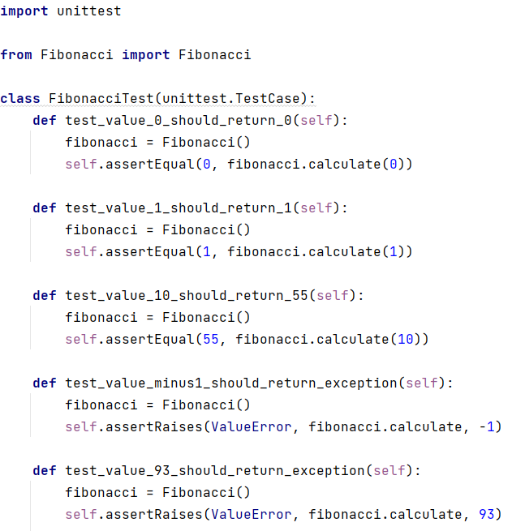
Production and test code for the Fibonacci example

Slide 20
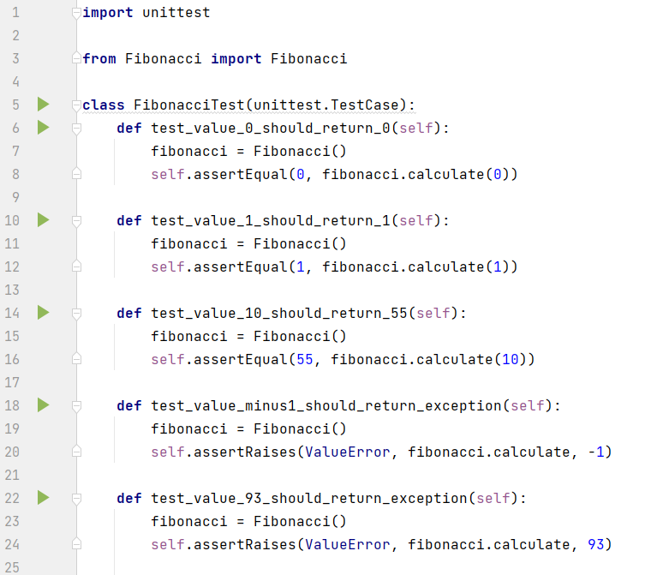
Test execution in PyCharm
Run the whole suite or a single test case with the PyCharm built-in runner

Slide 21
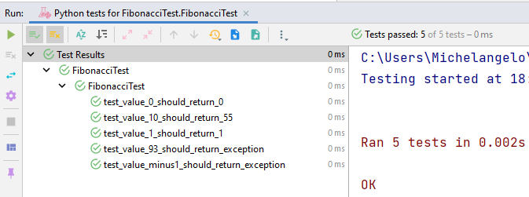
Watch test outcomes
Status
Run tests, results (success, failure, ignore, error) and execution time

Slide 22
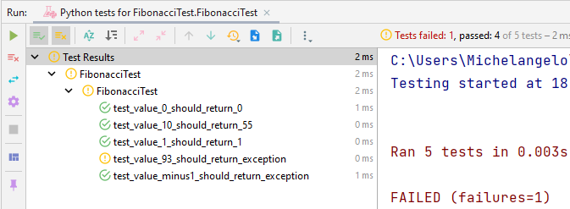
Watch test outcomes (if there was a failure)
Status
Run tests, results (success, failure, ignore, error) and execution time

Slide 23
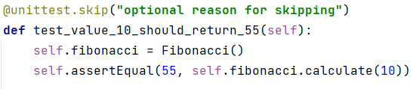
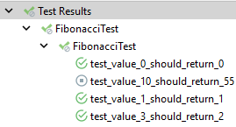
Skipping test methods
The @unittest.skip decorator before a test method allows to skip it during the test execution

Slide 24
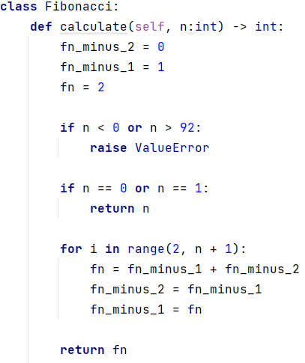
Testing and exception
Invalid values (the upper bound is arbitrary)

Slide 25
Testing and exception
To ensure that a given exception has been raised, the assertRaises assertion is used
assertRaises(exception_type, method, arguments)
In our Fibonacci example:
assertRaises(ValueError, Fibonacci.calculate, -1)

Slide 26
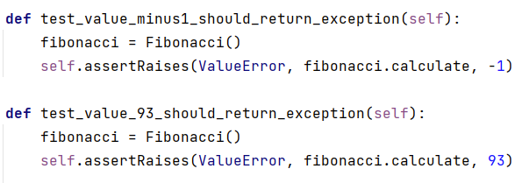
Testing and exception
ValueError
is expected

Slide 27
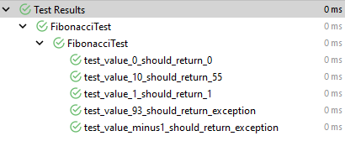
Test execution order
Test execution order is not secure, do no write test methods (or classes) that depend on others!!!

Slide 28
Assertions on real numbers
When dealing with real numbers, an “exact” assertion may be not feasible
E.g., due to number approximations
unittest provides a useful assertion:
assertAlmostEqual(first, second, places=7, msg=None, delta=None)
It asserts that two real numbers (i.e., expected and actual) are equal within a positive delta

Slide 29
Assertions on real numbers
assertAlmostEqual(first, second, places=7, msg=None, delta=None)
first: first input number
second: second input number
places: how many decimal places are considered for approximation
delta: delta value for approximation

Slide 30
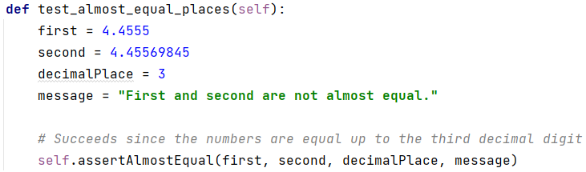
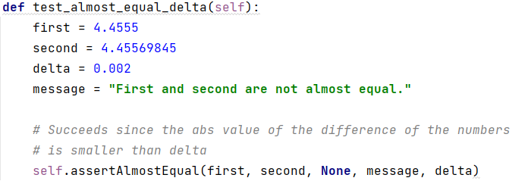
Assertions on real numbers

Slide 31
unittest execution cycle
Select a test runner, which creates a new instance of the test class
Invoke the setUp method on the test class (if any)
Run a test method
Invoke the tearDown method on the test class (if any)
1. Test Runner Selection
2. Setup
3. Run
4. Teardown

Slide 32
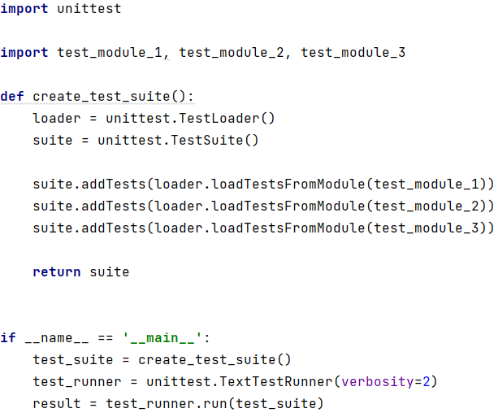
Execute the entire test suite
Test classes
Build the test suite by loading the test cases from each test module
How detailed the output should be
Execute the test suite

Slide 33
unittest execution cycle
Select a test runner, which creates a new instance of the test class
Invoke the setup method on the test class (if any)
Run a test method
Invoke the teardown method on the test class (if any)
1. Test Runner Selection
2. Setup
3. Run
4. Teardown

Slide 34
Setup method
Called before each test case. It helps creating a test fixture, namely:
A set of objects needed to consistently run the tests
It is defined as follows (method names must be exactly as below):
@classmethod
def setUpClass(cls): …
def setUp(self): …
It is run once, before all test cases
It is run before each test method

Slide 35
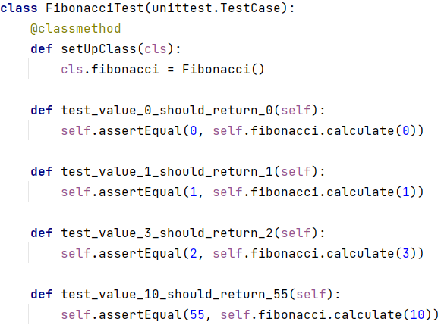
Setup method example
Setup
method
Fixture

Slide 36
unittest execution cycle
Select a test runner, which creates a new instance of the test class
Invoke the setup method on the test class (if any)
Run a test method
Invoke the teardown method on the test class (if any)
1. Test Runner Selection
2. Setup
3. Run
4. Teardown

Slide 37
unittest execution cycle
Select a test runner, which creates a new instance of the test class
Invoke the setup method on the test class (if any)
Run a test method
Invoke the teardown method on the test class (if any)
1. Test Runner Selection
2. Setup
3. Run
4. Teardown

Slide 38
Teardown method
Called after each test case execution. It is directed to restore the environment to the same condition it was before the test execution.
It is defined as follows (method names must be exactly as below) :
@classmethod
def tearDownClass(cls): …
def tearDown(self): …
It is run after each test method
It is run once after all tests have been executed

Slide 39
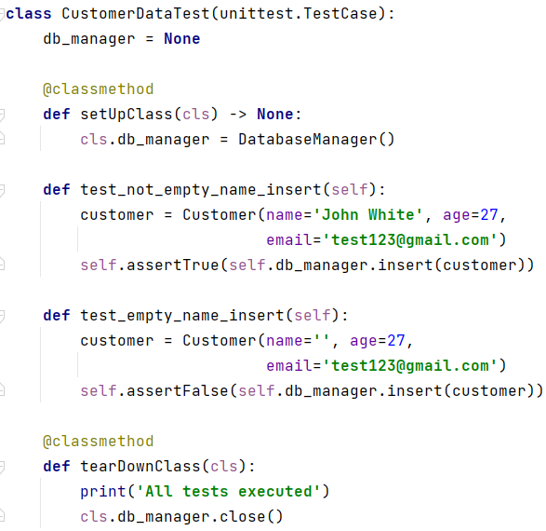
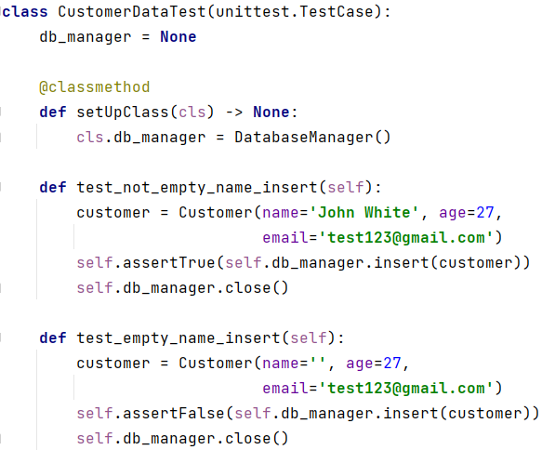
Teardown method example
Teardown
method
Fixture

